Slide 1
ECE3003 – MICROCONTROLLER AND ITS APPLICATIONS J-COMPONENT REVIEW-2 Winter 2018-2019
WIRELESS DATA TRANSMITTER
GROUP MEMBERS
17BEC1208 D. CHARAN
17BLC1030 T. JAYANTH KUMAR
17BEC1195 M. B. V. SRI HARSHA
17BEC1124 K. MADHU SEKHAR
Presented to : Prof. V. Prakash, AP, SENSE, VIT Chennai

Slide 2
OBJECTIVE OF THE PROJECT:
To construct a wireless data transmitter which can transmit data wirelessly
This project is used to communicate or transmit a message from one place to another place wirelessly.
The keypad entered data is encrypted by using the Microcontroller and the encrypted data is transmitted wirelessly.
At the receiver end the signal is received by the standard receiver and the analog signal is fed to the Microcontroller and it is decrypted by the Microcontroller
The data is displayed on an LCD display.

Slide 3
COMPONENTS REQUIRED :
1. AT89S52 Microcontroller
2. Encoder (HT12E)
3. Decoder (HT12D)
4. RF module
5. Numeric keypad
6. LCD 16X2
7. Keil uVision
8.Developer Board
Proteus 8 software

Slide 4
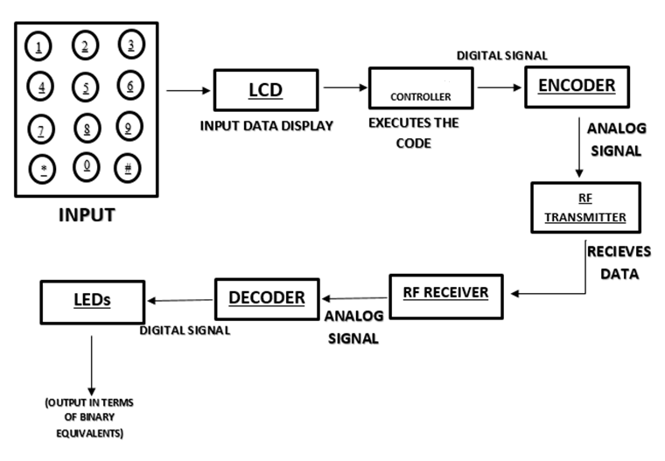
BLOCK DIAGRAM :
MICRO

Slide 5
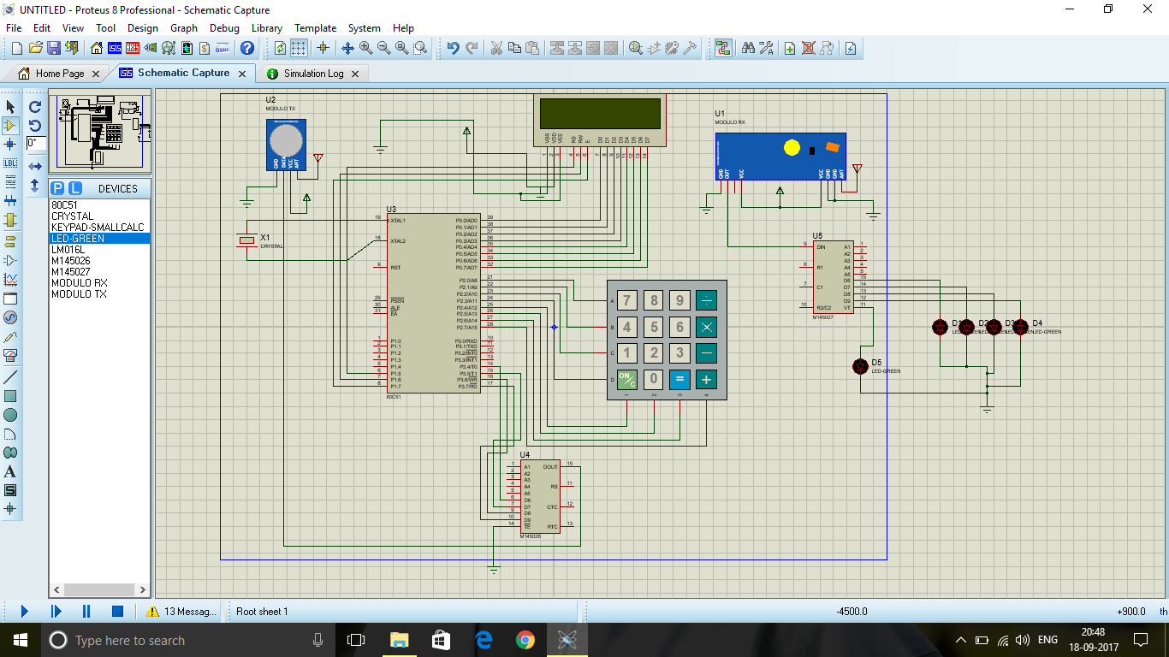
SCHEMATIC DIAGRAM

Slide 6
FLOW CHART
Start
Enter the input through keypad
Micro controller executes the code and sends signal to the encoder
Transmitter send the data wirelessly
This data is received by the receiver and decoded
Binary equivalent of the data is displayed through the led’s
End

Slide 7
PSUEDO CODE:
Start: Initialize the LCD to port 0
Assign the RS, RW and E pins to P1.5, P1.6, P1.7
Assigning the P0.7 for checking the busy of LCD
Assign the keypad pins to Port 2
Define the delay program
Define the required functions
Giving initial commands to the LCD
P3=0x00;
init_lcd();
cmd_lcd(0x80);
display_lcd(" RF TRANSMITTER ");
DELAYMS(1000);

Slide 8
cmd_lcd(0x01);
cmd_lcd(0x80);
display_lcd("ENTER ANY KEY...");
cmd_lcd(0xC0);
key_cnt=0;
while(key_cnt!=1)
{
KEYPAD();
if(fkey==1)
{
fkey=0;
a[j] = key_store;
byte=a[j];
lcd_data(byte);

Slide 9
key_cnt++;
}
}
DELAYMS(300);
cmd_lcd(0x01);
cmd_lcd(0x80);
display_lcd(" TX IN PROGRESS ");
DELAYMS(200);
DELAYMS(300);
cmd_lcd(0x01);
cmd_lcd(0x80);
display_lcd(" TX IN PROGRESS ");
DELAYMS(200);

Slide 10
Concepts Learned:
We learnt the configuration of ports of 8051 microcontroller.
We learnt how to interface the LCD display and Keypad to the microcontroller.
We learnt how to code and simulate the microcontroller circuit in Proteus software.
We learnt how to burn the code into a microcontroller.
We learnt how to use 8051 microcontroller in our project Wireless Data Transmitter.

Slide 11
APPLICATIONS:
Any data or information can be transmitted faster with a high speed.
It can be used in apps like Share it, Xender etc.
Data in the servers can be transmitted wirelessly in a LAN.
It can be used in remote controls, Radios etc.
It is very helpful for workers, doctors working in remote areas as they can be in touch with medical centers.

Slide 12
Difficulties faced:
We had difficulties while getting 8051 microcontroller Development board.
We faced difficulties while assembling the components of our project in the proteus and simulating it.
We had difficulties while burning the code into the microcontroller.
We faced difficulties while assembling our project in Hardware.

Slide 13
TIMELINE :
REVIEW 0 : Choosing a Topic and analyse on it.
REVIEW 1 : Simulating the circuit using Proteus software.
REVIEW 2 : Connecting the components.
REVIEW3 : Presenting the working model with the output

